Slide 1
Distributed Systems
Lecture 1- Introduction

Slide 2
Outline
Introduction
Definitions
Examples
Related Concepts
Pros and Cons of Distributed Systems
Goals of Distributed Systems
Transparency
Scalability
Openness
Connecting Users and Resources
Types of Distributed Systems
Distributed Computing Systems
Distributed Information Systems
Distributed Pervasive Systems
Summary

Slide 3
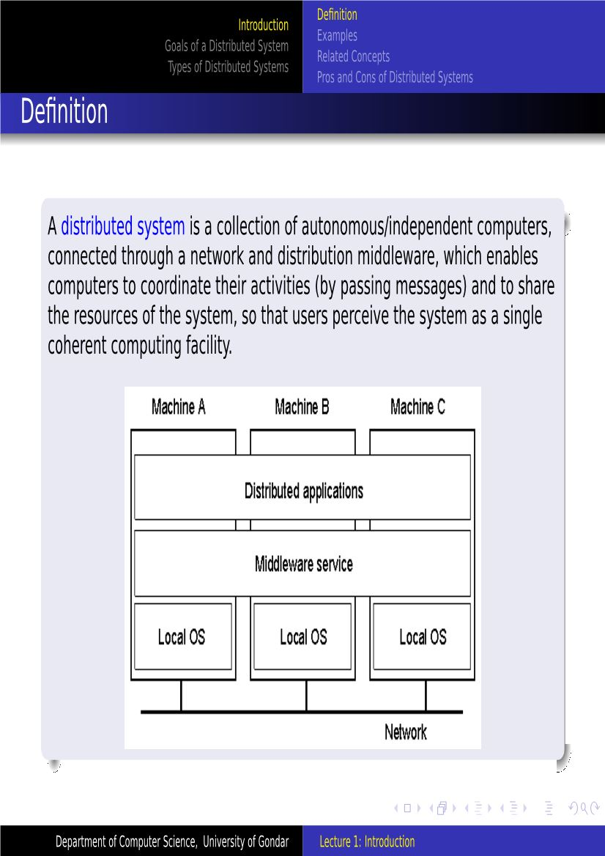

Slide 4
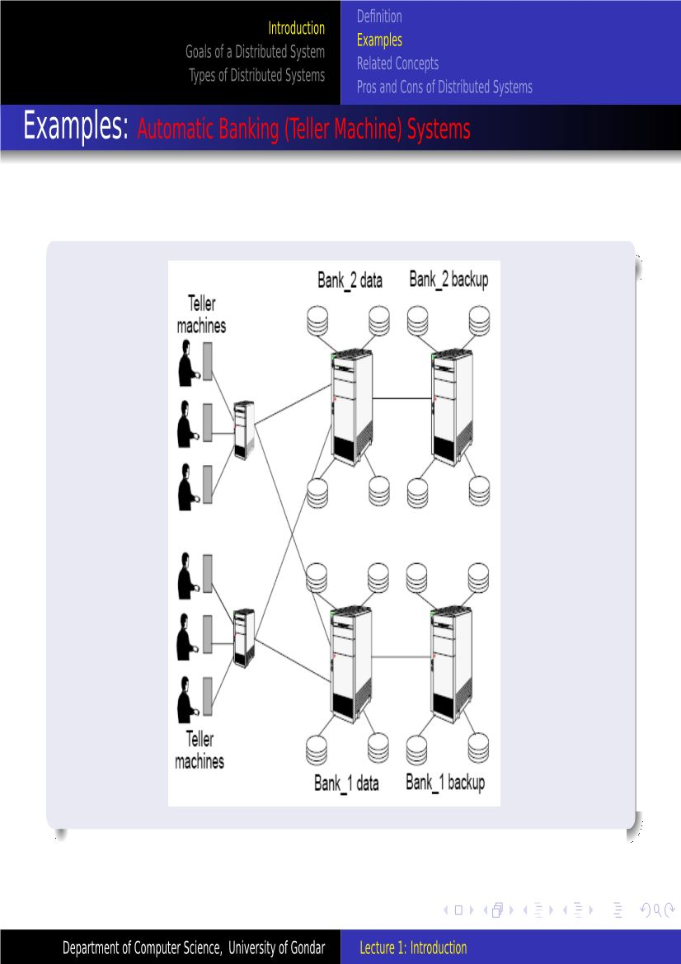

Slide 5
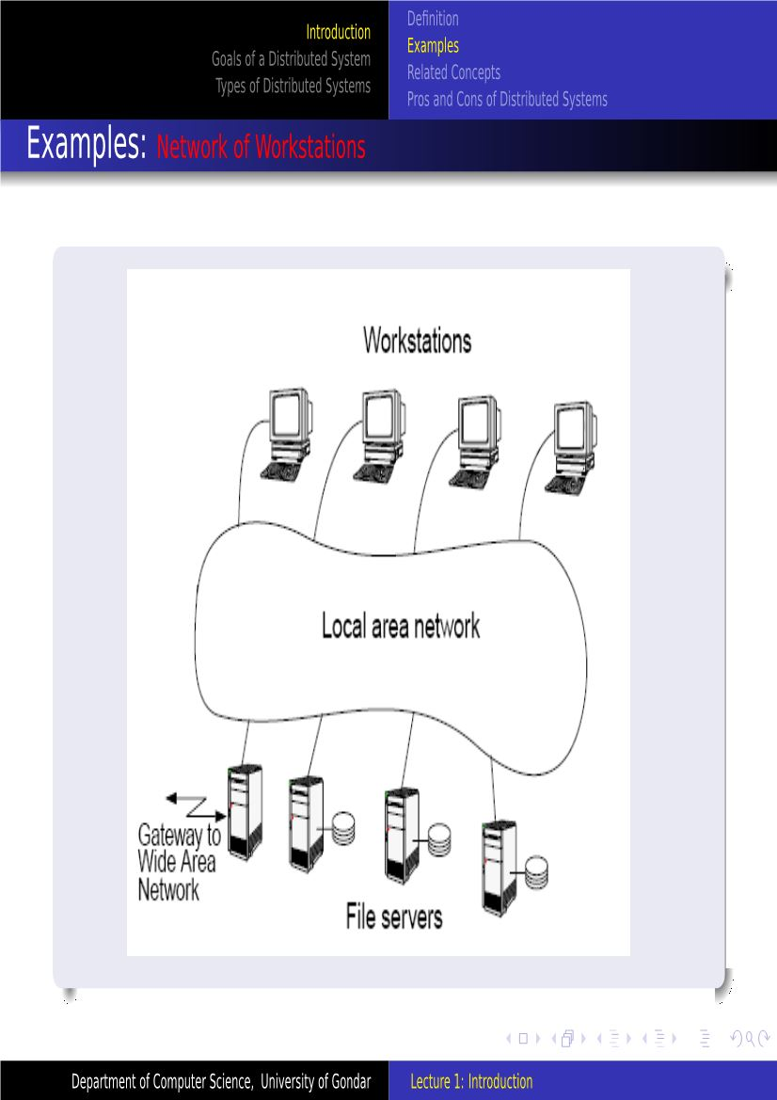

Slide 6
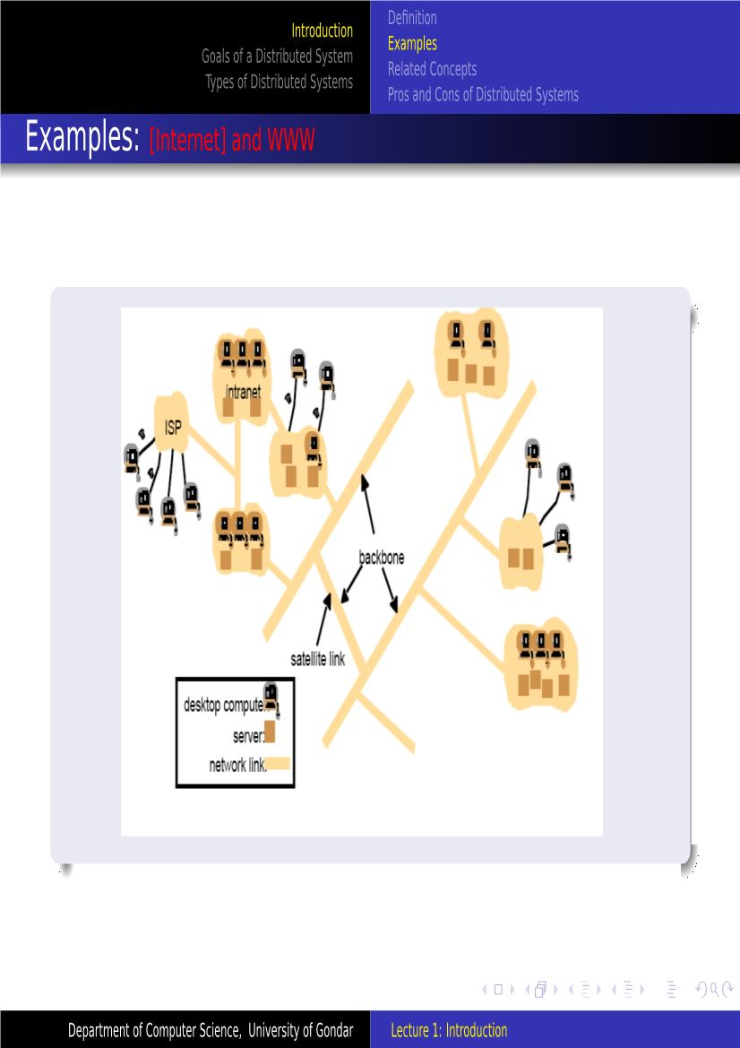

Slide 7
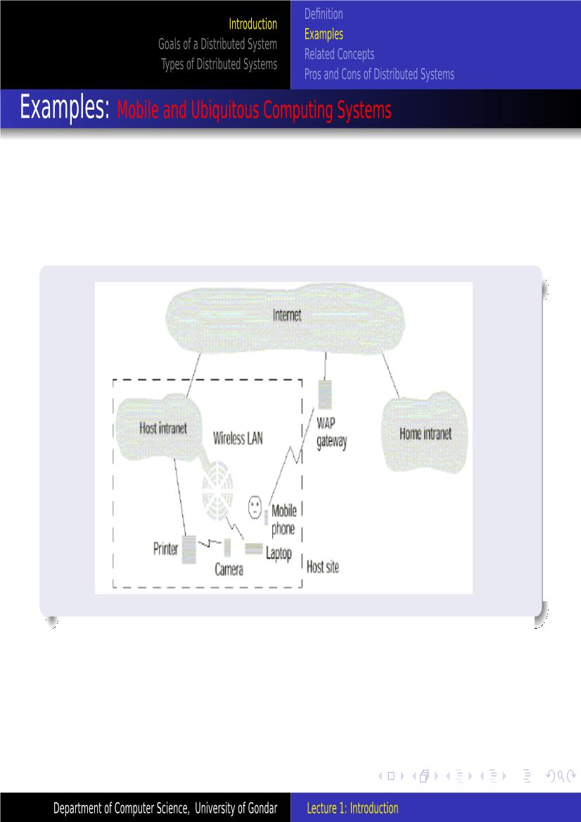

Slide 8
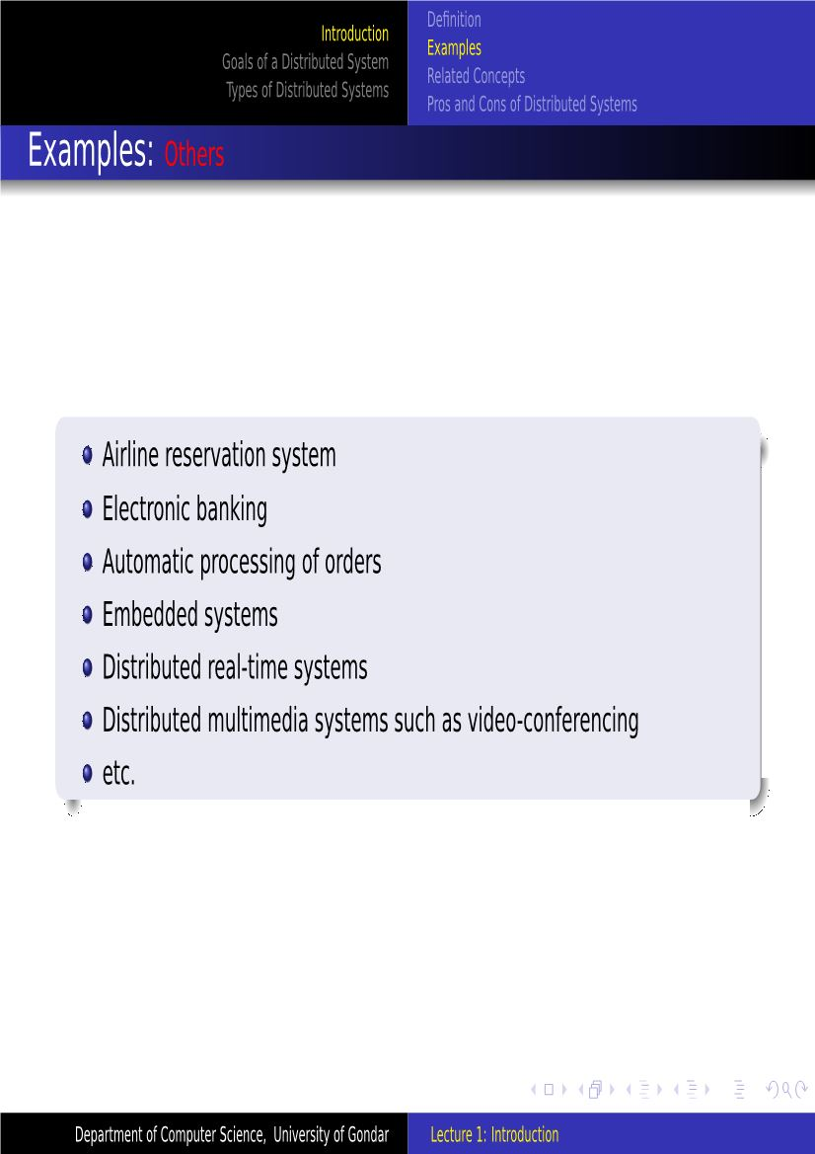

Slide 9
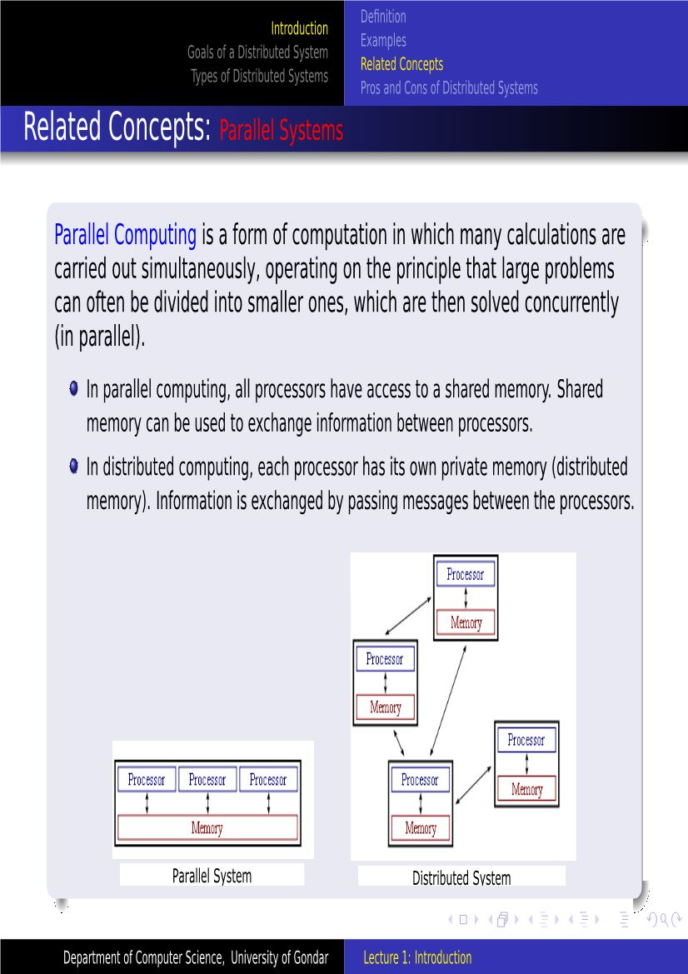

Slide 10
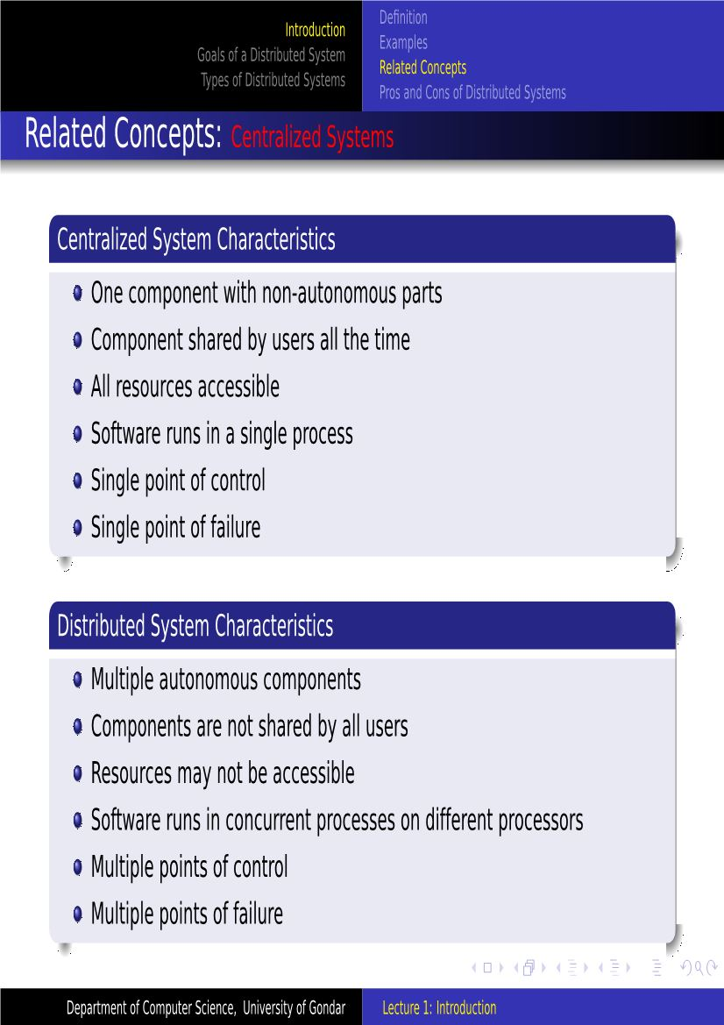

Slide 11
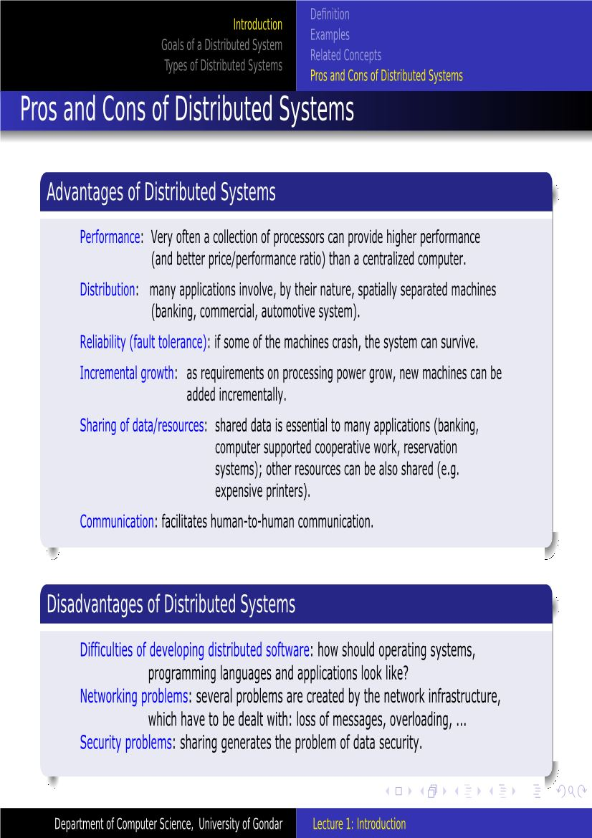

Slide 12
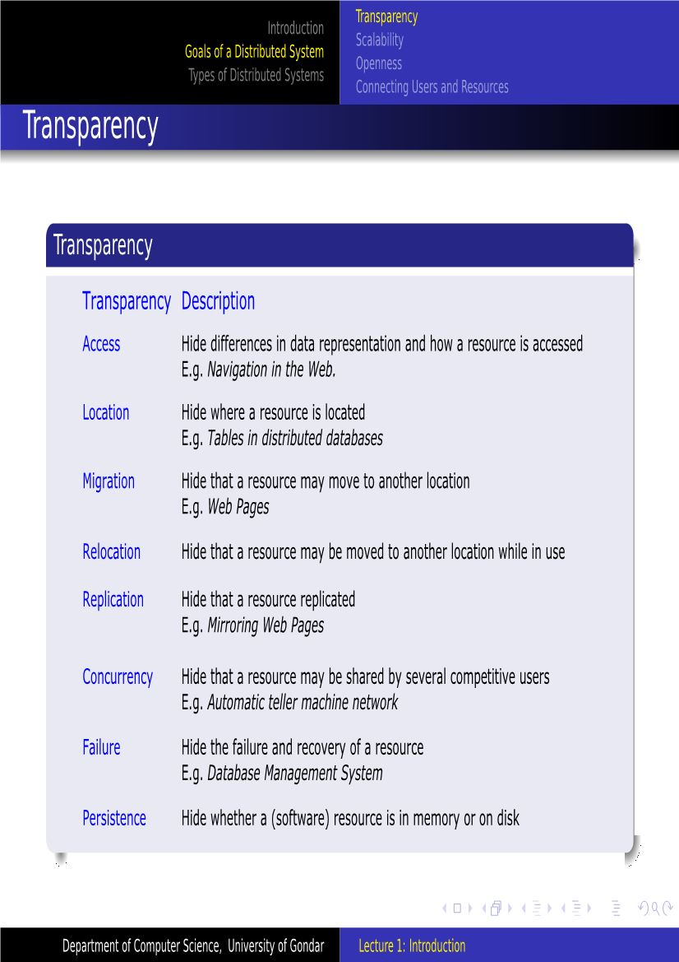

Slide 13
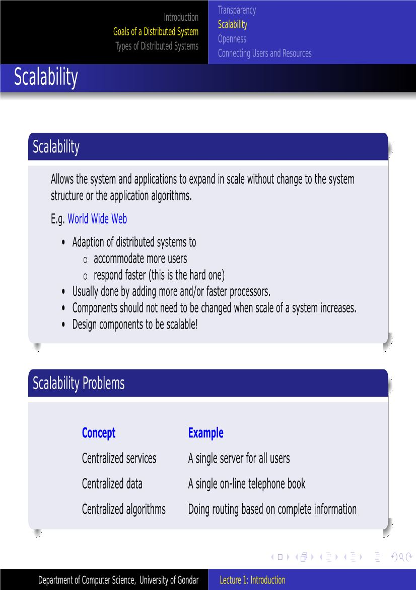

Slide 14
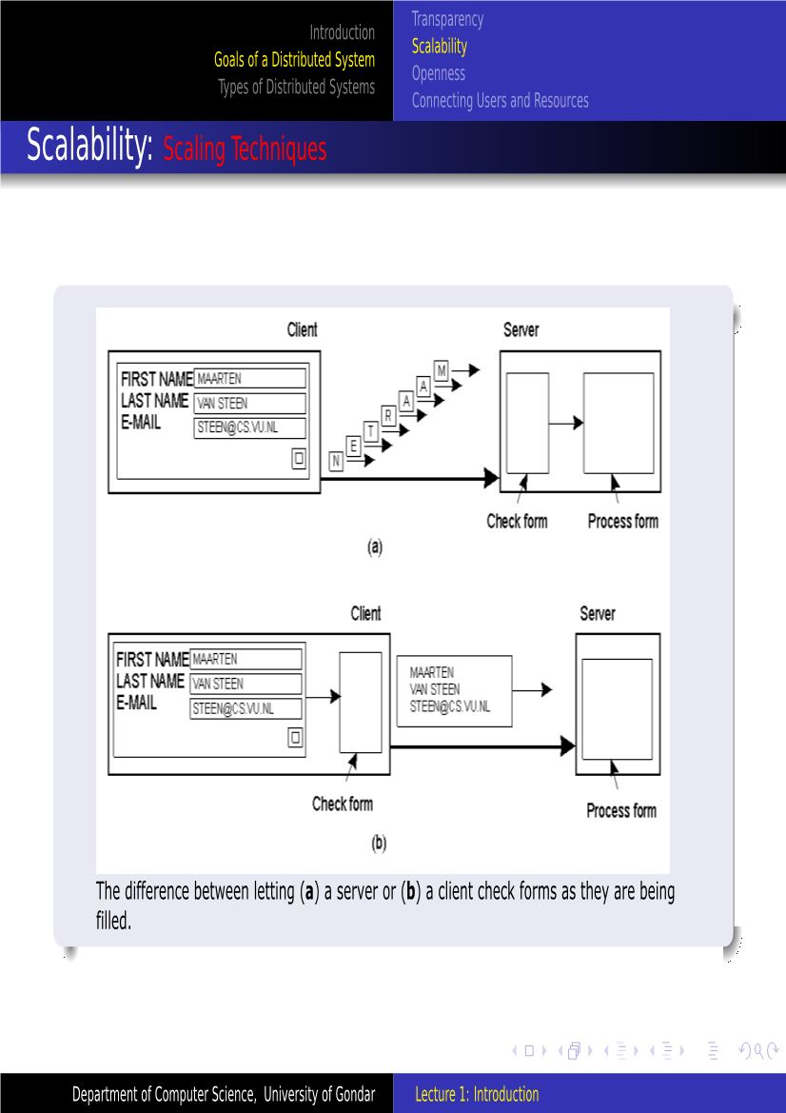
Scaling Techniques
Hiding Communication Latencies
To achieve geographical scalability
Asynchronous communication
Shipping Code
Distribution
Distribution involves taking a component, splitting it into smaller parts, and subsequently spreading those parts across the system.
An excellent example of distribution is the Internet Domain Name System (DNS). The DNS name space is hierarchically organized into a tree of domains, which are divided into nonoverlapping zones.
Replication
scalability problems often appear in the form of performance degradation, it is generally a good idea to actually replicate components across a distributed system. Replication not only increases availability, but also helps to balance the load between components leading to better performance.
Caching: Special forming of replication

Slide 15


Slide 16
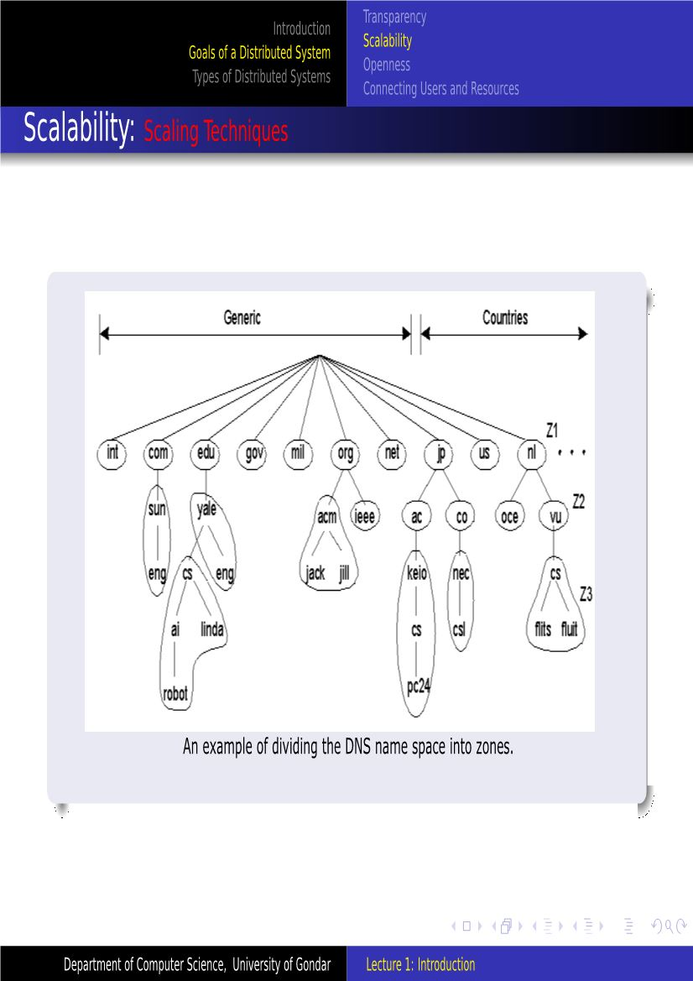
Distribution

Slide 17
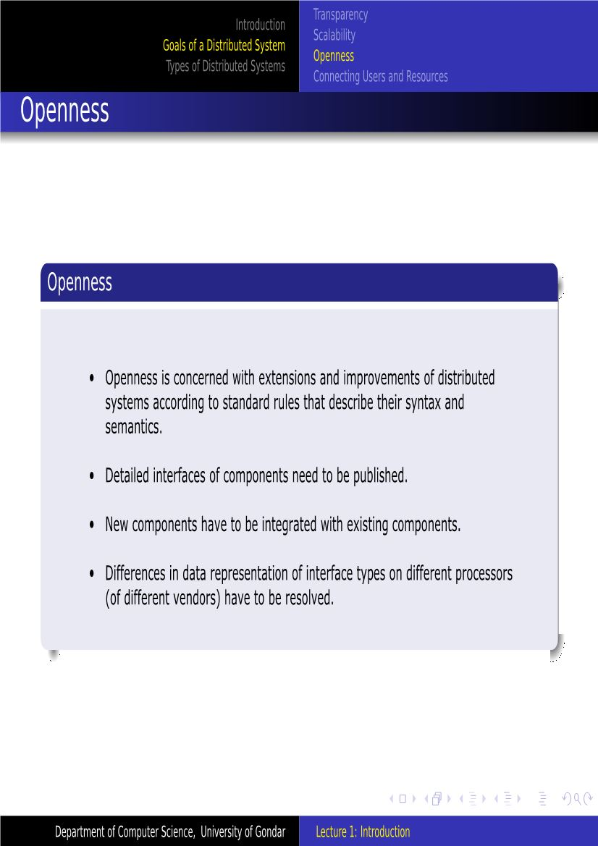
An open distributed system is a system that offers services according to standard rules that describe the syntax and semantics of those services

Slide 18
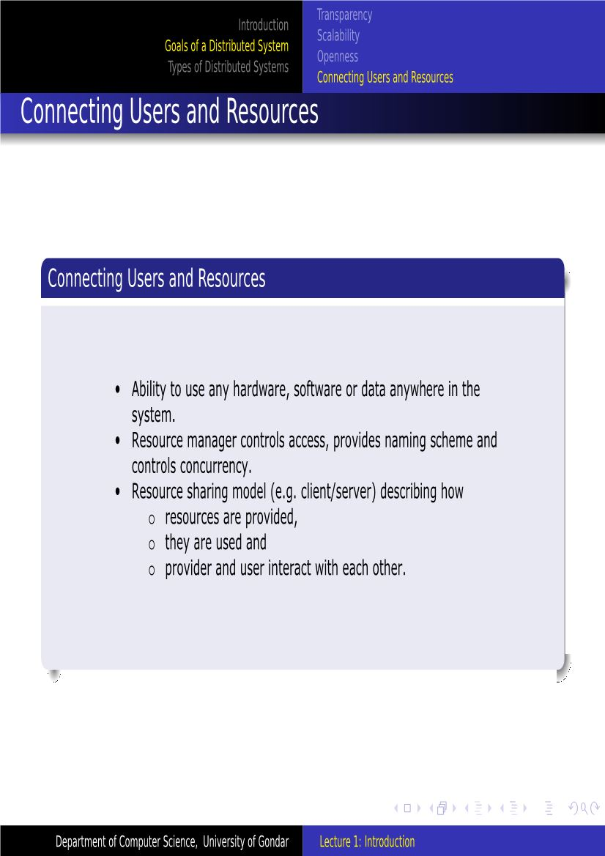

Slide 19
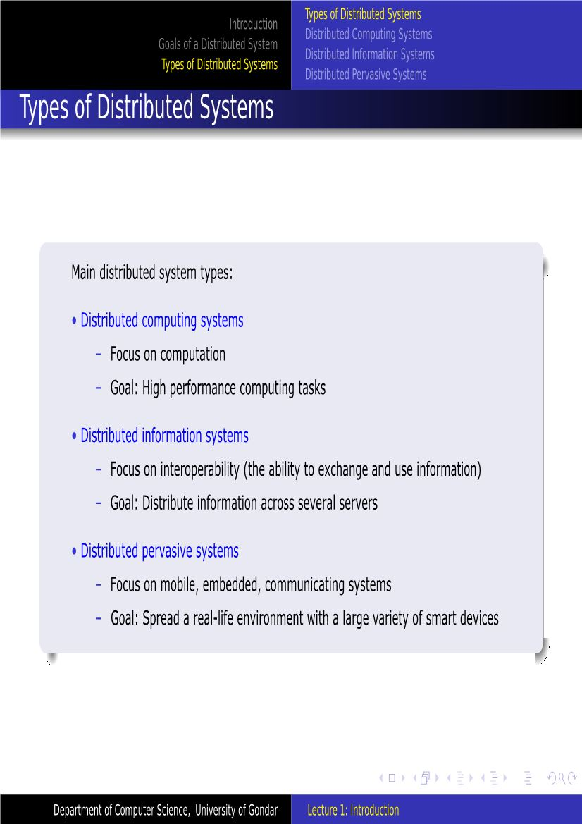

Slide 20
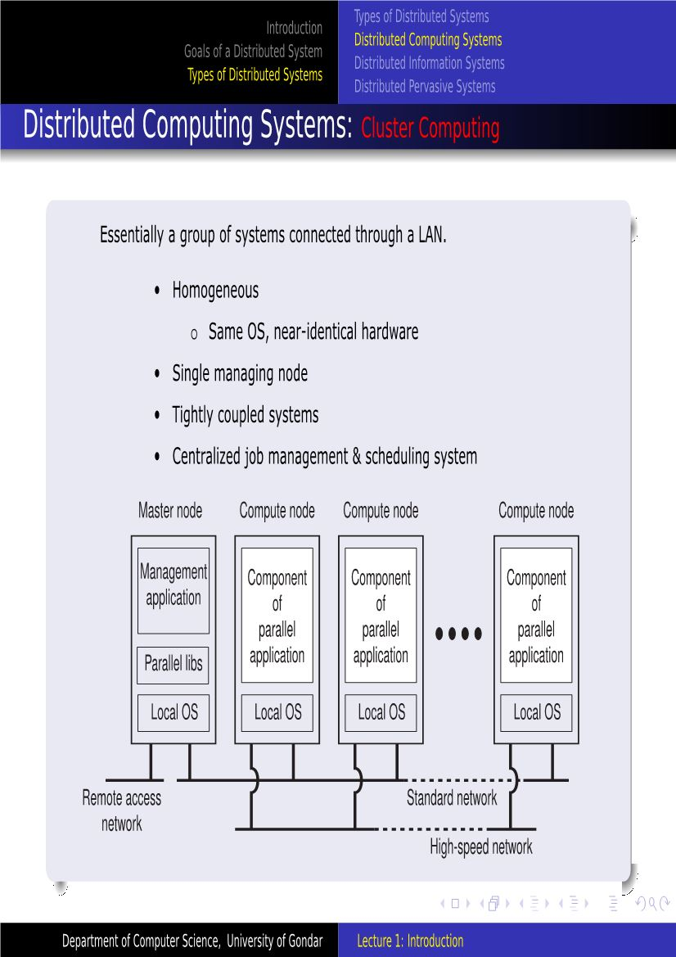

Slide 21
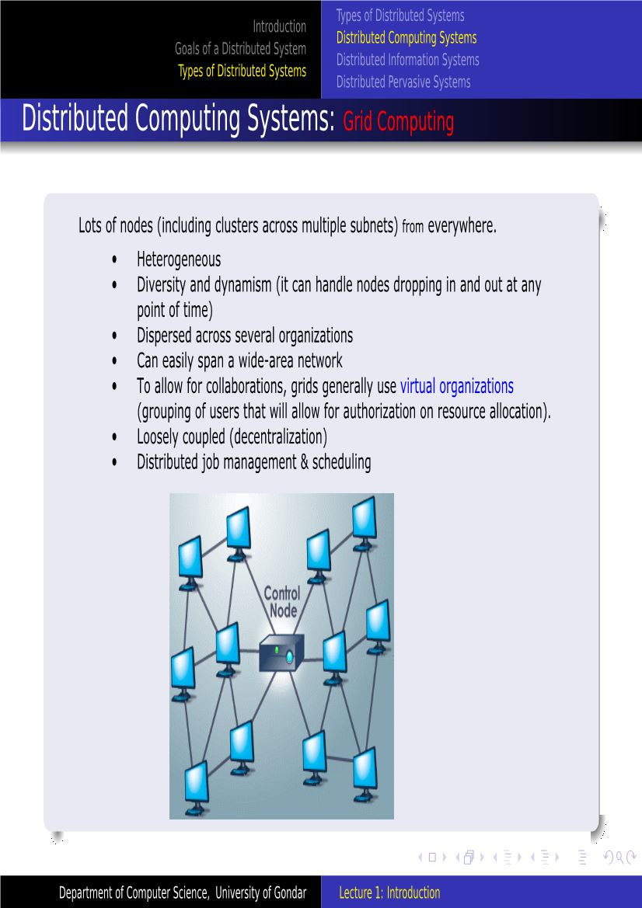

Slide 22
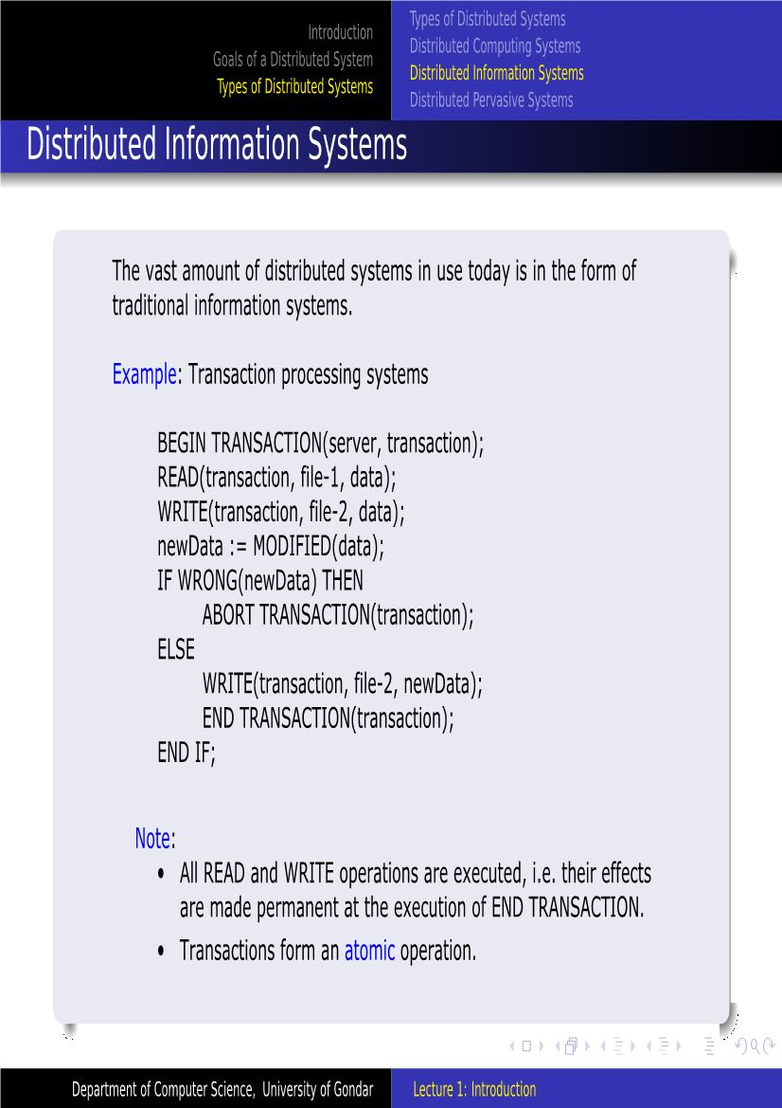

Slide 23
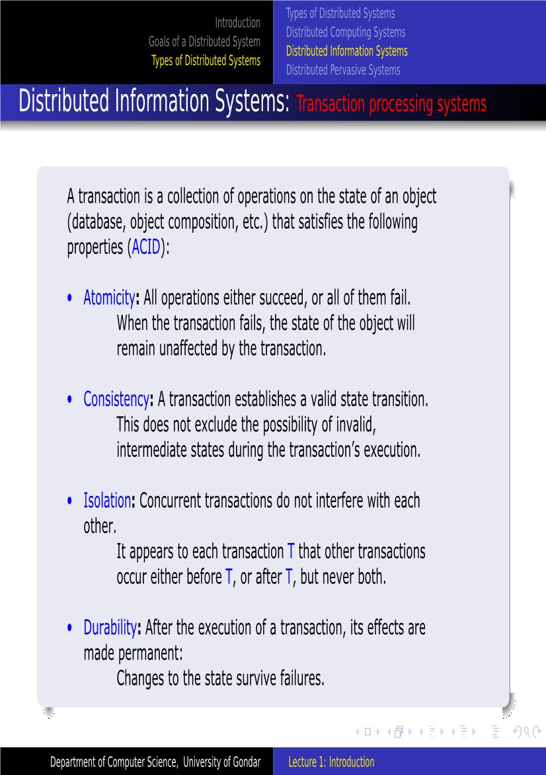

Slide 24
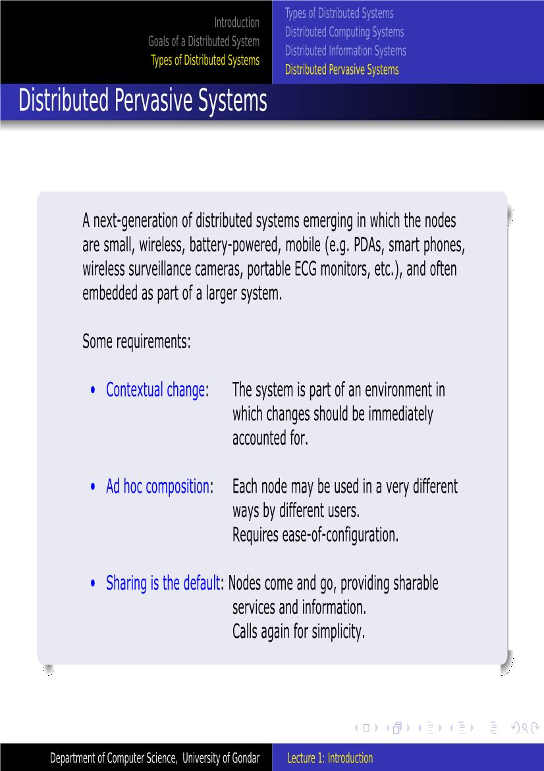

Slide 25
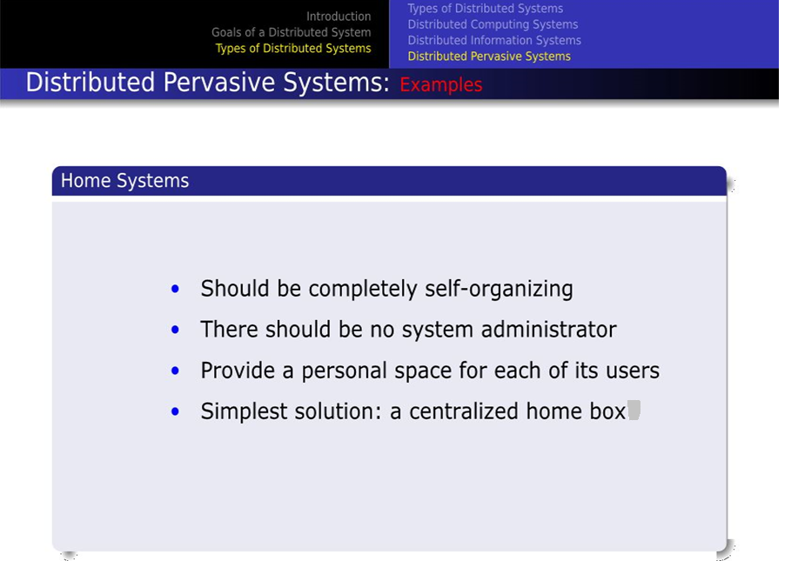

Slide 26
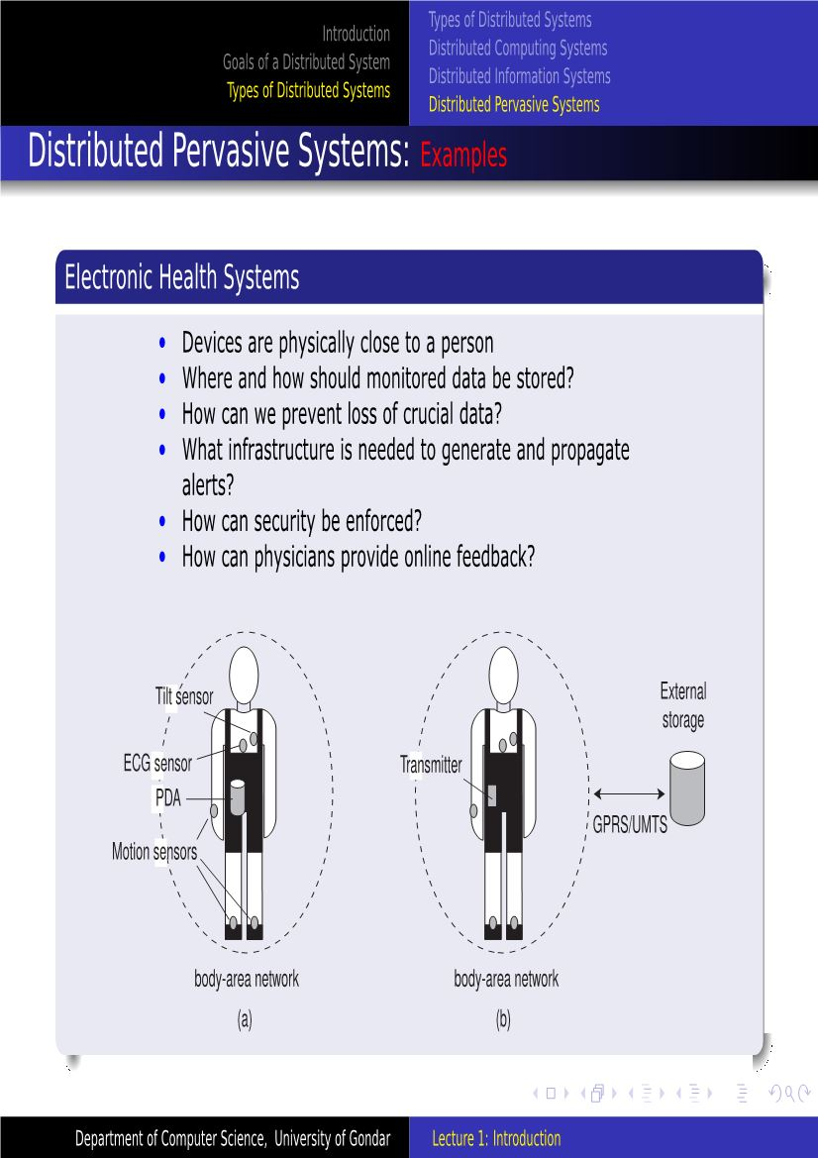

Slide 27
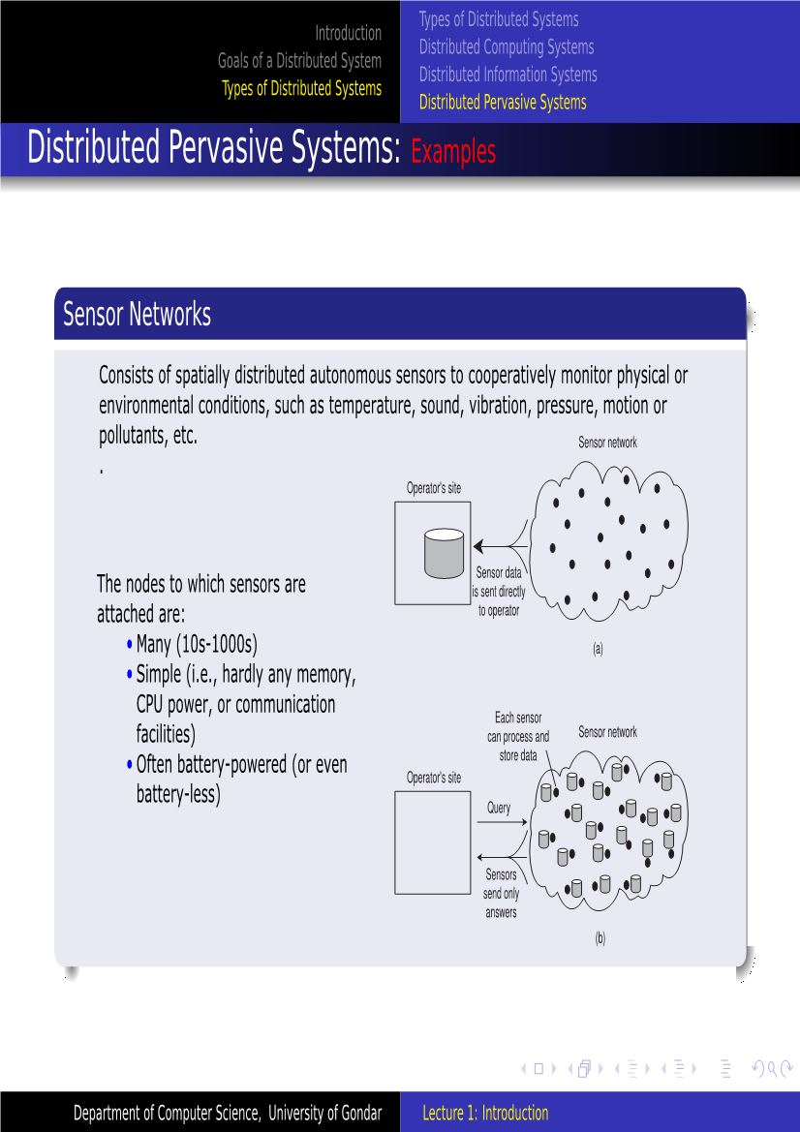

Slide 28
End of the Chapter

